Slide 1
Friend Function -
If a function is defined as a friend function in C++, then the protected and private data of a class can be accessed using the function.
By using the keyword friend, compiler knows the given function is a friend function.
For accessing the data, the declaration of a friend function should be done inside the body of a class starting with the keyword friend.
Declaration of friend function in C++ -
class class_name
{
friend data_type function_name(argument/s);
};
NOTE - In the above declaration, the friend function is preceded by the keyword friend. The function can be defined anywhere in the program like a normal C++ function. The function definition does not use either the keyword friend or scope resolution operator.

Slide 2

Characteristics of a Friend Function -
The function is not in the scope of the class to which it has been declared as a friend.
It cannot be called using the object as it is not in the scope of that class.
It can be invoked like a normal function without using the object.
It cannot access the member names directly and has to use an object name and dot membership operator with the member name.
It can be declared either in the private or the public part.

Slide 3
#include<iostream.h>
#include<conio.h>
class Box
{
private:
int length;
public:
Box()
{
length = 0;
}
friend int printLength(Box);
};
int printLength(Box b1)
{
b1.length += 10;
return b1.length;
}
void main()
{
Box b;
cout<<"Length of box: "<< printLength(b)<<endl;
}
Example of Friend Function

Slide 4
A friend class can access both private and protected members of the class in which it has been declared as friend.
#include<iostream.h>
#include<conio.h>
class A
{
int x =5;
friend class B;
};
class B
{
public:
void display(A &a)
{
cout<<"value of x is : "<<a.x;
}
};
int main()
{
A a;
B b;
b.display(a);
return 0;
}
Example of Friend Class

Slide 5
Inline Function –
What is inline function?
The inline functions are a C++ enhancement feature to increase the execution time of a program.
Functions can be instructed to compiler to make them inline so that compiler can replace those function definition wherever those are being called.
Compiler replaces the definition of inline functions at compile time instead of referring function definition at runtime.
If function is big (in term of executable instruction etc) then, compiler can ignore the “inline” request and treat the function as normal function.

Slide 6
How to make function inline?
To make any function as inline, start its definitions with the keyword “inline”.
Syntax -
inline int add(int a, int b)
{
return (a + b);
};
Advantages –
It speeds up your program by avoiding function calling overhead.
It save overhead of variables push/pop on the stack, when function calling happens.
It save overhead of return call from a function.
It increases locality of reference by utilizing instruction cache.
By marking it as inline, you can put a function definition in a header file (i.e. it can be included in multiple compilation unit, without the linker complaining)

Slide 7
Disadvantages –
It increases the executable size due to code expansion.
C++ inlining is resolved at compile time. Which means if you change the code of the inline function, you would need to recompile all the code using it to make sure it will be updated
When used in a header, it makes your header file larger with information which users don’t care.
As mentioned above it increases the executable size, which may cause thrashing in memory. More number of page fault bringing down your program performance.
Sometimes not useful for example in embedded system where large executable size is not preferred at all due to memory constraints.

Slide 8
#include<iostream.h>
#include<conio.h>
inline int sqr(int x)
{
int y;
y = x * x;
return y;
}
int main()
{
int a = 3, b;
b = sqr(a);
cout <<"ans is "<<b;
return 0;
}
Example of Inline Function

Slide 9
C++ Inheritance –
In C++, inheritance is a process in which one object acquires all the properties and behaviors of its parent object automatically. In such a way, we can reuse, extend or modify the attributes and behaviors which are defined in other class.
In C++, the class which inherits the members of another class is called derived class and the class whose members are inherited is called base class. The derived class is the specialized class for the base class.
Advantages -
Code reusability - Now we can reuse the members of your parent class. So, there is no need to define the member again. So less code is required in the class.
Types Of Inheritance -
Single inheritance
Multiple inheritance
Hierarchical inheritance
Multilevel inheritance
Hybrid inheritance

Slide 10
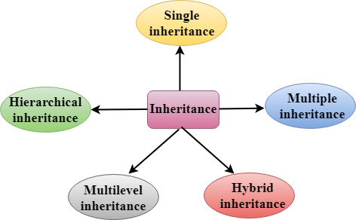

Slide 11
Derived Classes - A Derived class is defined as the class derived from the base class.
Syntax - class derived_class_name :: visibility-mode base_class_name
{
// body of the derived class.
}
where -
derived_class_name - It is the name of the derived class.
visibility mode - The visibility mode specifies whether the features of the base class are publicly inherited or privately inherited. It can be public or private.
base_class_name - It is the name of the base class.
When the base class is privately inherited by the derived class, public members of the base class becomes the private members of the derived class. Therefore, the public members of the base class are not accessible by the objects of the derived class only by the member functions of the derived class.
When the base class is publicly inherited by the derived class, public members of the base class also become the public members of the derived class. Therefore, the public members of the base class are accessible by the objects of the derived class as well as by the member functions of the base class.

Slide 12

Note -
In C++, the default mode of visibility is private.
The private members of the base class are never inherited.
Single Inheritance -
Single inheritance is defined as the inheritance in which a derived class is inherited from the only one base class.

Slide 13
Single Level Inheritance Example: Inheriting Fields -
#include<iostream.h>
#include<conio.h>
class Account
{
public:
float salary = 60000;
};
class Programmer: public Account
{
public:
float bonus = 5000;
};
void main()
{
Programmer p1;
cout<<"Salary: "<<p1.salary<<endl;
cout<<"Bonus: "<<p1.bonus<<endl;
}

Slide 14
Single Level Inheritance Example: Inheriting Methods -
#include<iostream.h>
#include<conio.h>
class Animal
{
public:
void eat()
{
cout<<"Eating..."<<endl;
}
};
class Dog: public Animal
{
public:
void bark()
{
cout<<"Barking...";
}
};
void main()
{
Dog d1;
d1.eat();
d1.bark();
}

Slide 15
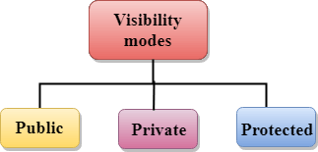
How to make a Private Member Inheritable –
The private member is not inheritable. If we modify the visibility mode by making it public, but this takes away the advantage of data hiding.
C++ introduces a third visibility modifier, i.e., protected. The member which is declared as protected will be accessible to all the member functions within the class as well as the class immediately derived from it.
Visibility modes can be classified into three categories -
Public - When the member is declared as public, it is accessible to all the functions of the program.
Private - When the member is declared as private, it is accessible within the class only.
Protected - When the member is declared as protected, it is accessible within its own class as well as the class immediately derived from it.

Slide 16
Visibility of Inherited Members -
Base class visibility | Derived class visibility
 | Public | Private | Protected
Private | Not Inherited | Not Inherited | Not Inherited
Protected | Protected | Private | Protected
Public | Public | Private | Protected

Slide 17

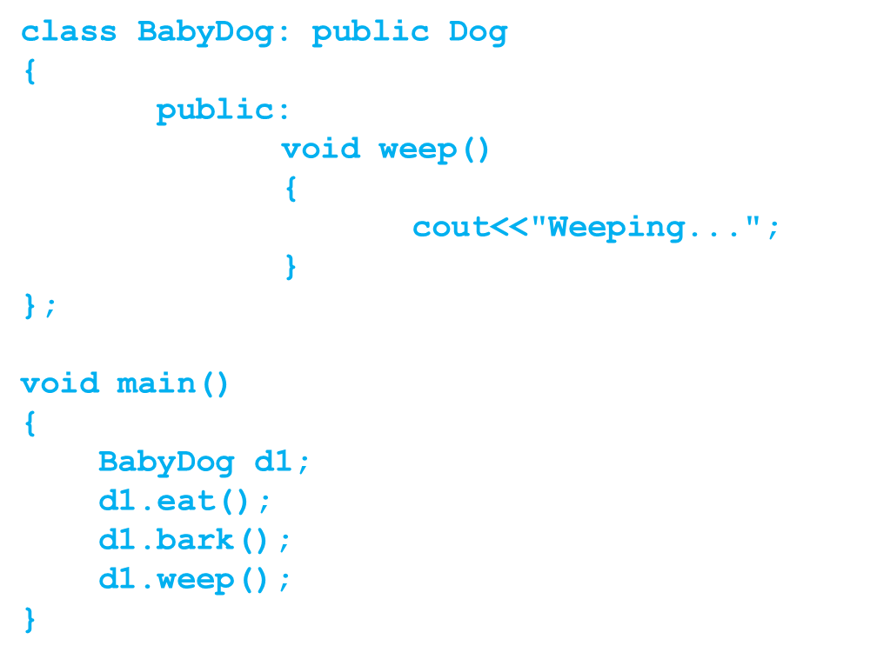
Multilevel Inheritance - Multilevel inheritance is a process of deriving a class from another derived class.
#include<iostream.h>
#include<conio.h>
class Animal
{
public:
void eat()
{
cout<<"Eating..."<<endl;
}
};
class Dog: public Animal
{
public:
void bark()
{
cout<<"Barking..."<<endl;
}
};

Slide 18
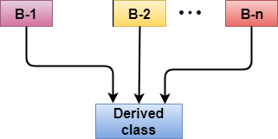
Multiple Inheritance -
Multiple inheritance is the process of deriving a new class that inherits the attributes from two or more classes.
Ambiguity Resolution in Inheritance –
Ambiguity can be occurred in using the multiple inheritance when a function with the same name occurs in more than one base class.
Note: Example of Multiple Inheritance and Ambiguity Resolution discussed later.

Slide 19
#include<iostream.h>
#include<conio.h>
class A
{
protected:
int a;
public:
void get_a(int n)
{
a = n;
}
};
class B
{
protected:
int b;
public:
void get_b(int n)
{
b = n;
}
};
class C : public A, public B
{
public:
void display()
{
cout << "The value of a is : " << a;
cout << "The value of b is : " << b;
cout << "Addition of a and b is : “ << (a+b);
}
};
void main()
{
C c;
c.get_a(10);
c.get_b(20);
c.display();
}
Example of Multiple Inheritance

Slide 20
#include<iostream.h>
#include<conio.h>
class A
{
public:
void display()
{
cout << "Class A" << endl;
}
};
class B
{
public:
void display()
{
cout << "Class B" << endl;
}
};
class C : public A, public B
{
void view()
{
A :: display();
B :: display();
}
};
void main()
{
C c;
c.display();
}
Example of Ambiguity Resolution

Slide 21
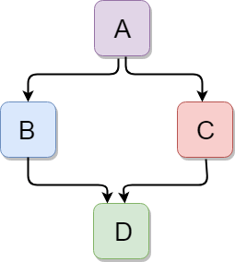
Hybrid Inheritance -
Hybrid inheritance is a combination of more than one type of inheritance.
#include<iostream.h>
#include<conio.h>
class A
{
protected:
int a;
public:
void get_a()
{
cout << "Enter the value of 'a' : " << endl;
cin>>a;
}
};

Slide 22
class B : public A
{
protected:
int b;
public:
void get_b()
{
cout << "Enter the value of 'b' : " << endl;
cin>>b;
}
};
class C
{
protected:
int c;
public:
void get_c()
{
cout << "Enter the value of c is : " << endl;
cin>>c;
}
};

Slide 23
class D : public B, public C
{
protected:
int d;
public:
void mul()
{
get_a();
get_b();
get_c();
cout << "Multiplication of a,b,c is : " <<a*b*c<< endl;
}
};
void main()
{
D d;
d.mul();
}

